Slide 1
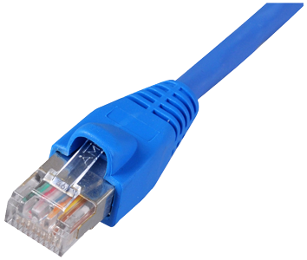
Who we are?
Cyber Security Experts
Social Engineering Prevention
Firewalls, Antivirus, Networks and Servers
Data protection
We also do:
Infrastructure
Remote/Managed IT
Telecom
PC Support

Slide 2
Social Engineering: The Human Element of Cyber Security

Slide 3
What is Social Engineering?
Attacker uses human interaction to obtain or compromise information
Attacker my appear unassuming or respectable
Pretend to be a new employee, repair man, etc.
May even offer credentials
By asking questions, the attacker may piece enough information together to infiltrate a companies network
May attempt to get information from many sources
Notes:
The most simple way to put it, social engineering is when someone uses human interaction to obtain or compromise data.

Slide 4
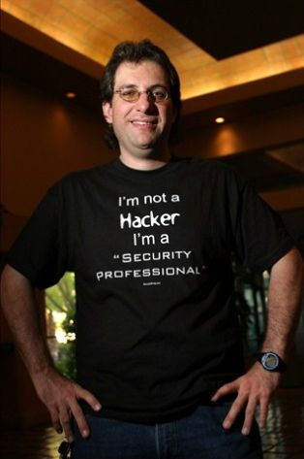
Who is Kevin Mitnick?
Kevin David Mitnick (born August 6, 1963) is an American computer security consultant, author and hacker, best known for his high-profile 1995 arrest and later five years in prison for various computer and communications-related crimes
While in Federal custody, authorities even placed Mitnick in solitary confinement; reportedly, he was deemed so dangerous that if allowed access to a telephone he could start a nuclear war by just whistling into it.
Notes:
Who is Kevin Mitnick? Kevin Mitnick is a well known social engineer and hacker turned cyber security consultant. - Read second bullet point

Slide 5
A quote from Kevin Mitnick
A company can spend hundreds of thousands of dollars on firewalls, intrusion detection systems and encryption and other security technologies, but if an attacker can call one trusted person within the company, and that person complies, and if the attacker gets in, then all that money spent on technology is essentially wasted.
Notes:
Here is a quote from Kevin Mitnick that really underlines how serious the human element is, in cyber security.

Slide 6
A classic (and real) Example
In 2007 Carlos Hector Flomenbaum from Argentina (an alias) Managed to steal $28 Million in diamonds in a social engineering attack
Philip Claes, spokesman for the Diamond High Council in Antwerp, said that the area had been fitted with a security system costing more than $1 million. The lesson, he said, was that "despite all the efforts one makes in investing in security, when a human error is made nothing can help"
Notes:
Here is a classic and real example of social engineering. Please take a moment to read it and when you are done if you would like to guess how it was done raise your hand.

Slide 7
Types of Attacks
Phishing
Pretexting
Tailgating or Piggybacking
Quid Pro Quo
Dumpster diving
Baiting
Notes:
Here are the most common types of social engineering attacks

Slide 8
Phishing
Phishing scams might be the most common types of social engineering attacks used today. Most phishing scams demonstrate the following characteristics:
Seek to obtain personal information, such as names, addresses and social security numbers.
Use link shorteners or embed links that redirect users to suspicious websites in URLs that appear legitimate.
Incorporates threats, fear and a sense of urgency in an attempt to manipulate the user into acting promptly.

Slide 9
Phishing (continued..)
Use of deceptive mass mailing
Can target specific entities (“spear phishing”)
Prevention:
Honeypot email addresses
Education
Awareness of network and website changes
Create a reporting procedure

Slide 10
Pretexting
Pretexting is the act of creating and using an invented scenario (the pretext) to engage a targeted victim in a manner that increases the chance the victim will divulge information or perform actions that would be unlikely in ordinary circumstances.
Notes:
Pretexting is the act of using an invented scenario (often based on previous research) that increases the likelihood that the victim will divulge information or perform actions that breach a companies security.

Slide 11
Pretexting (continued..)
Example: Attacker gathers information on employees and help desk contact information. Attacker calls the help desk pretending to be someone else (typically an employee with authority). Gains access to sensitive information by inventing a scenario where they are familiar enough with the company to make help desk comfortable assisting them.
Prevention:
Assign pins for calling the help desk
Don’t do anything on someone’s order
Stick to the scope of the help desk

Slide 12
Tailgating
Impersonates a delivery driver or utility worker and follows employee inside building
Ultimately obtains unauthorized building access
Prevention
Require badges
Employee training
Security officers
No exceptions!
Notes:
Tailgating often takes advantage of good manners. We are all taught at a young age to hold doors for people and attackers know this.

Slide 13
Quid Pro Quo
Quid Pro Quo attacks promise a benefit in exchange for information. This benefit usually assumes the form of a service
Example: Attacker calls random numbers at a company, claiming to be from technical support. Eventually, they reach someone with a legitimate problem. Grateful tech support called them back, they will follow the attackers instructions. The attacker will "help" the user, but will really have the victim type commands that will allow the attacker to install malware.

Slide 14
Quid Pro Quo (continued..)
Prevention:
Determine what is sensitive information
Create protocols for access verification
Keep staff informed on IT support changes
Create a reporting procedure

Slide 15
Dumpster diving
Looking through the trash for sensitive information
Doesn’t have to be dumpsters: any trashcan will do
Prevention:
Easy secure document destruction
Lock dumpsters
Erase magnetic media
Notes:
You may think nothing that breaches security ever ends up in the trash, but if enough information can be pieced together it can make an attacker seem knowledgeable or trustworthy. Occasionally someone may leave a jackpot in the trash though, you never know.

Slide 16
Baiting
Baiting is in many ways similar to phishing attacks. However, what distinguishes them from other types of social engineering is the promise of an item or good that hackers use to entice victims
Example: Attacker creates USB Flash drive with malware on it and puts a label on it that sparks curiosity. Label might say something like: 2016 Financial Data or Employee Performance Reviews. Attacker then leaves the flash drives in places they can be found by a target company employee. A curious employee finds the flash drive and plugs it into their computer to see what is on it and unknowingly installs malware so the attacker has access.

Slide 17
Baiting (continued..)
Prevention:
Train employees to never insert any kind of media unless directed by supervisor
Train employees to always report found CD’s and USB drives.
If media is ever delivered via mail from an unknown source, always verify it is legitimate before installing

Slide 18
Weakest Link?
No matter how strong your:
Firewalls
Intrusion Detection Systems
Cryptography
Anti-virus software
You are the weakest link in computer security!
People are more vulnerable than computers
"The weakest link in the security chain is the human element" -Kevin Mitnick

Slide 19
Countermeasures
Standard Framework Establishing frameworks of trust on an employee/personnel level (i.e., specify and train personnel when/where/why/how sensitive information should be handled)
Scrutinizing Information Identifying which information is sensitive and evaluating its exposure to social engineering and breakdowns in security systems (building, computer system, etc.)
Security Protocols Establishing security protocols, policies, and procedures for handling sensitive information.
Training to Employees Training employees in security protocols relevant to their position. (e.g., in situations such as tailgating, if a person's identity cannot be verified, then employees must be trained to politely refuse.)
Event Test Performing unannounced, periodic tests of the security framework.
Review Reviewing the above steps regularly: no solutions to information integrity are perfect.
Waste Management Using a waste management service that has dumpsters with locks on them, with keys to them limited only to the waste management company and the cleaning staff. Locating the dumpster either in view of employees so that trying to access it carries a risk of being seen or caught, or locating it behind a locked gate.

Slide 20
Questions?
?
Notes:
Some talking points:
Can anyone think of any movies where social engineering was used?
Has anyone seen the movie Catch Me If You Can with Leonardo Dicaprio and Tom Hanks? It is a great movie based on a real social engineer (Frank Abagnale) who was able to scam airlines, banks and even escape police custody twice, once by tricking the department of corrections that he was actually an undercover prison investigator.
A common social engineering attack that most people have heard of is people calling around pretending to need bail for a family member.
We will be providing this and other training material on our website which is on the rack cards we have provided. We also will be offering various penetration tests and training for businesses that are interested in protecting themselves more.

